Slide 1
Flags of the Nations

Slide 2



Slide 3



Slide 4
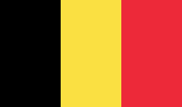
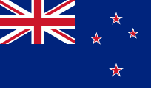

Slide 5
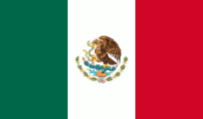
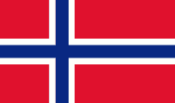

Slide 6



Slide 7
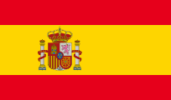


Slide 8
Flag Answers
Afghanistan
Australia

Slide 9
Canada
Denmark

Slide 10
Belgium
New Zealand

Slide 11
Mexico
Norway

Slide 12
Ireland
South Korea

